Slide 1

WELCOME
Technical
Analysis
Concepts
Introduction
to
Stock Markets

Slide 2
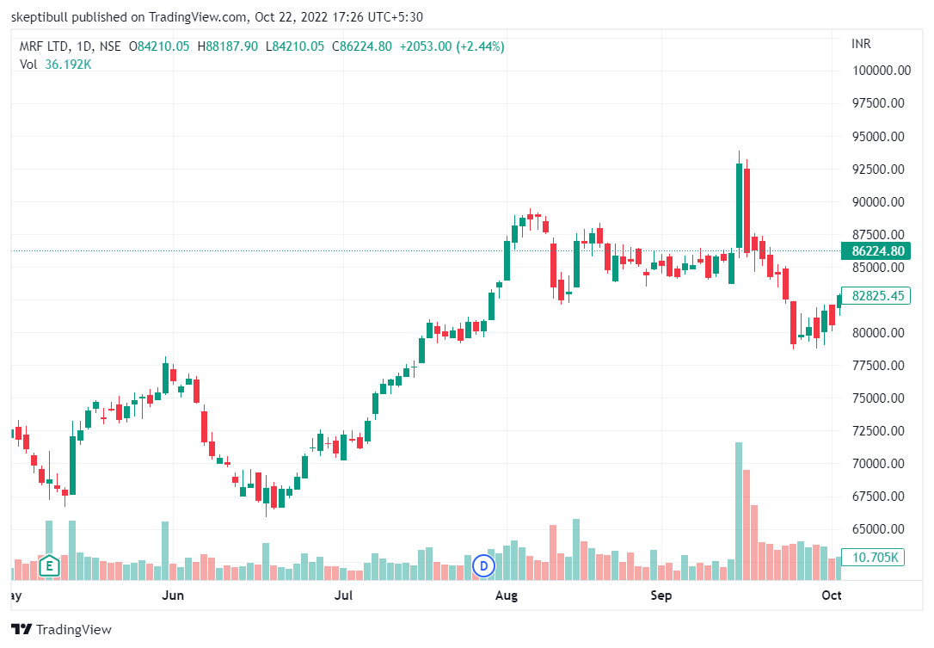
Technical
Analysis
Chart
Analysis
=
Price
Volume

Slide 3
Technical Analysis:
Candlestick
Trend and Trendline
Support & Resistance
Moving Average
Breakout
Volume
Purpose:
Entry
Exit

Slide 4
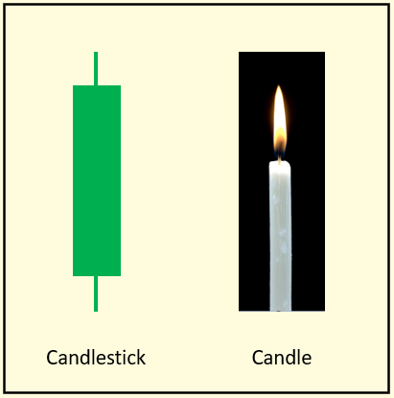

Slide 5
Shadow
Body
Shadow

Slide 6
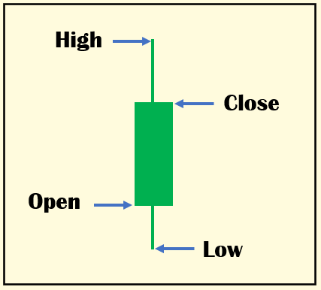

Slide 7
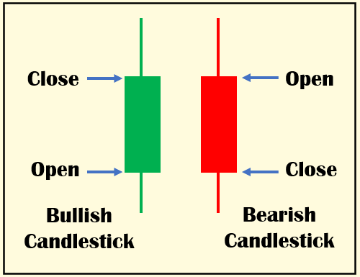

Slide 8
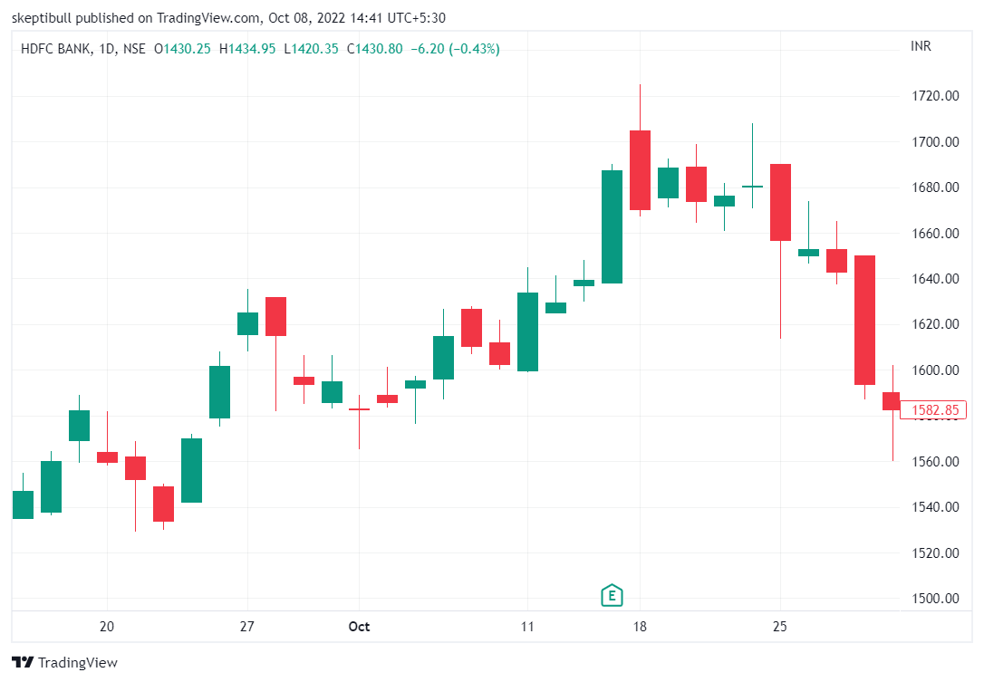

Slide 9
Trend & Trendline:
3 Trends
Uptrend – Bullish Market – Price Rises
Downtrend – Bearish Market – Price Falls
Sideways – Range Bound

Slide 10
Support & Resistance:
Support – price level where demand exceeds supply and fall in prices is halted. Acts like a floor.
Resistance – price level where supply exceeds demand and rise in prices is stopped. Acts like a ceiling.

Slide 11
Volume:
No. of shares traded for a given time frame, usually a day.
Shows commitment of market participants to price.
Important for trend to sustain.

Slide 12
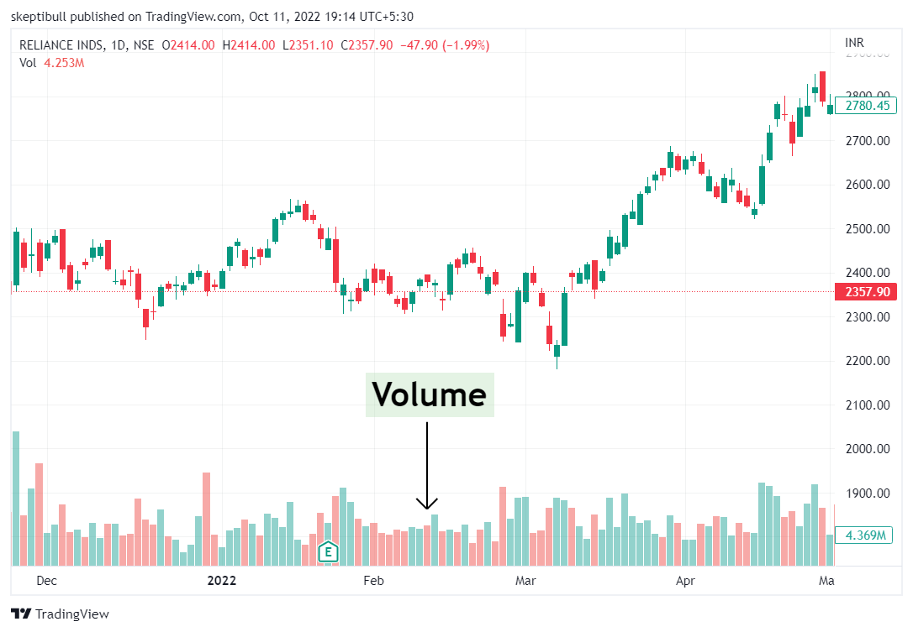

Slide 13
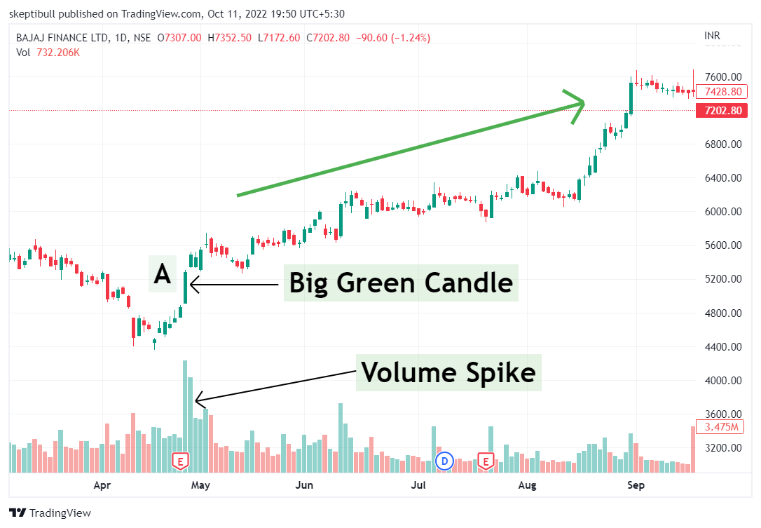

Slide 14
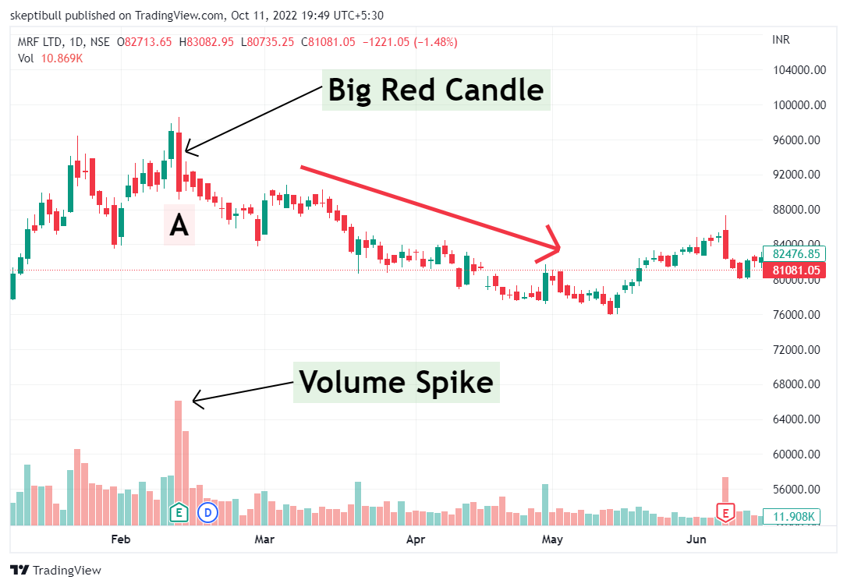

Slide 15
Breakout:
When trendline, support or resistance is breached after price consolidation
Breakout with volume is preferred.

Slide 16
Moving Average:
Moving Average is a line passing through average price of a stock.

Slide 17
Next Lecture on
Investment Strategies

Slide 18
#06283D
#F4F4F2
#FEB202
#FF8701
#4A206A

